Slide 1
QSLing
Tom Schaefer, NY4I
UPARC 2020

Slide 2
Agenda
QSL overview
Paper or electronic?
Paper QSL Techniques
Electronic QSL Techniques
Questions

Slide 3
QSL
“A QSL is the final courtesy of a QSO”
Awards
Fun receiving unique cards
But how do we get the cards?

Slide 4
Paper QSLs
Cards on the Wall!
Some awards require paper QSL (WAC)
Options to receive cards:
Direct Mail
Bureau

Slide 5
Paper QSLs via Direct
Direct - It’s not cheap!
Domestic ($1.25)
SASE (if required)
First Class round-trip: $1.00
Card + 2 envelopes
International ($3.50)
Global Forever Stamp: $1.15
$2-$3 dollars to place in envelope for return postage (more if rare DXPedition is appreciated)
Card and envelopes

Slide 6
Direct QSL Hints
Use QRZ and follow DXs QSL directions EXACTLY!
Look for US QSL Manager (cheaper)
Decide if you need the paper card
Do they use LOTW? Lists available to tell you (logging program/cluster/QRZ)
Use UTC date
See if station has an online log

Slide 8
Bureau (“Buro”) System
Incoming and Outgoing
Clearing house for QSLs
Cheap but veeeeeeerrrrrrryyyyyyy slow
Follow directions
Not all hams use bureau
Incoming bureau workers are VOLUNTEERS (be kind…)

Slide 9
Incoming Bureau
Inbound for “4” calls
One letter Prefixes (K4, W4, N4)
Carolina DX Association
http://www.cdxa.org/w4qsl-bureau/index.php
Two letter prefixes
Sterling Park ARC
http://www.qsl.net/sterling/uf1.htm
Normally 6x9 envelope
Callsign in upper right and postage

Slide 10
Outgoing QSL Bureau
ARRL Outgoing Service
ARRL Membership is required
See if country has an incoming bureau
Follow directions on QRZ for DX station.
Some hams just do not use their bureau
Sort cards, pay by weight and send them to ARRL (or drop them off at some hamfests)
Wait, wait, wait, wait, wait…
1-3 years not unusual

Slide 11
Electronic QSLs
LOTW, eQSL, QRZ
What you use depends why you QSL.
ARRL Awards (WAS, DXCC) require LOTW or paper card.
Triple-play WAS is ONLY LOTW.
It’s really not that hard to setup.
Any LOTW setup difficulty is to ensure “you are you”.
How else does ARRL know it is you?

Slide 12
LOTW Setup
Download TQSL
Create Certificate request (do NOT put a password on the certificate!)
You will receive post card
Go to LOTW and complete setup
If anyone does that, next month (Sat after meeting), we can help you setup.

Slide 13
Upload your Log
Send ADIF file (signed with TQSL) to LOTW
Other stations upload must match your QSL (no QSO fishing…)
Time within 15 minutes of each other.
TQSL handles multiple station locations.
Use a logging program
DXKeeper excels at LOTW operations

Slide 14
Awards – Paper Cards
For awards, you have to send some version of QSLs.
Some use honor system, some need actual card.
For DXCC, let ARRL keep your records…
Once you qualify for basic 100, periodically send your cards (or better, bring them to card checker).

Slide 15
Awards - LOTW
Select QSLs you want to use
Create application in LOTW
Pay for credits
Submit
Credit within 1-2 days
Demo

Slide 16
Online DXCC
https://p1k.arrl.org/onlinedxcc/
Submit cards manually or via ADIF file
Saves processing time for awards
Great for card checkers
Lists card in the sorted order

Slide 17
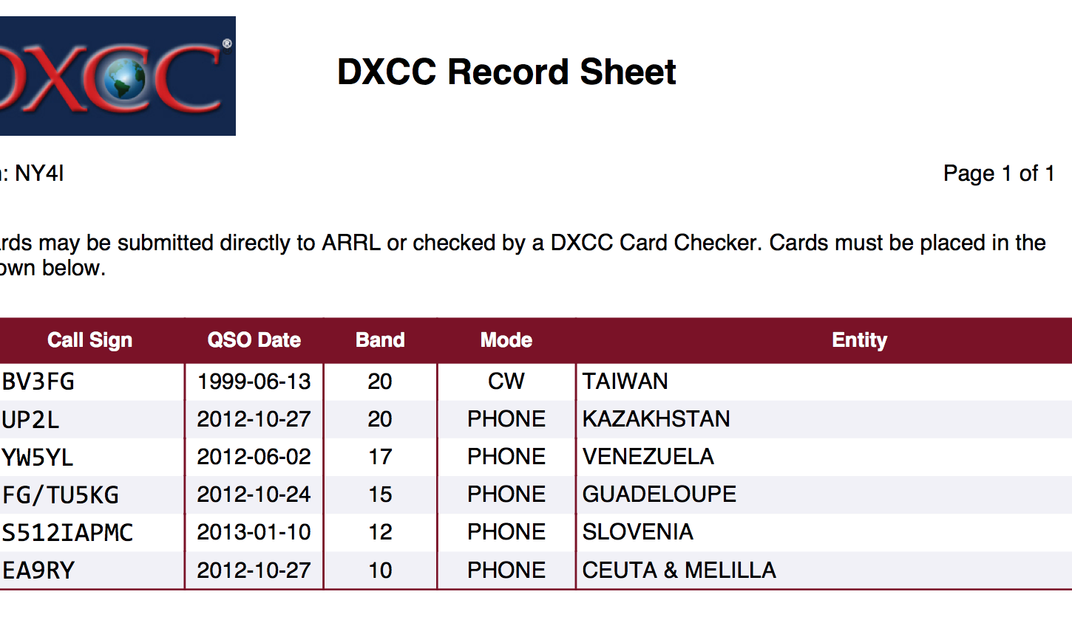
Online DXCC Application

Slide 18
Card Checkers or ARRL
You can mail cards to ARRL DXCC Desk but mail can be lost
You can visit cards checkers
Tampa Bay Hamfest
Orlando
Cards never leave you sight!
My preferred way

Slide 19
Questions

